Slide 1
FINAL PROJECT
House Pricing Prediction
Prepared by
Aydin Gokcen
Buck Matt
Channer Timothy
Le Phuong
Russo Estel

Slide 2

Overview of the Project
Create a machine learning model that can predict house prices in Ames City, IA, USA, for sellers and provide an interactive display for the users, where users can filter for various search criteria simultaneously.
Notes:
Create a machine learning model that can predict house prices in Ames City, IA, USA, for sellers and provide an interactive display for the users, where users can filter for various search criteria simultaneously.

Slide 3

Why was This Topic Chosen?
1- Many homeowners look to sell their homes. Using our display, users will be able to pinpoint what key factors need to be taken into consideration to maximize the sale of their home.
2- This model can be adapted to any country, and city, in the world.

Slide 4

Data Description
The original data was composed of 81 columns and 1460 rows and was filtered down to 18 columns and 1150 rows.
This Photo by Unknown Author is licensed under CC BY-SA-NC

Slide 5
Data Description The Fields
Lot Area (Lot size in square feet)
Lot Shape (General shape of property)
Neighbourhood (Physical locations within Ames city limits)
Building Type (Type of dwelling)
Year Built (Original construction date)
Year Remodeled (Same date as construction date if no remodeling or additions)
Heating Type (Type of heating)
Total House Square Feet (Total area of the house in square feet)
Number of Full Bathrooms (Full bathrooms above grade)
Number of Half Bathrooms (Half baths above grade)
Number of Bedrooms above ground floor (Does NOT include basement bedrooms)
Fireplaces (Yes/No)
Garage Type (Garage location)
Garage Cars (Size of garage in car capacity)
Paved Drive (Paved driveway)
Pool (Yes/No)
Year Sold (YYYY-MM-DD)
Sale Price

Slide 6

Database (6 Tables)
House Type: The list of types of houses
Garage Type: A list of types of garages
Neighbourhood: A list of neighborhoods in the City of Ames
Lot shape: A list of lot
Heating: A list of types of heating such as steam heat
House Sale History: A table includes house sales transactions in the City of Ames.

Slide 7
Technologies Used in the Project
Cleaning, Preparing and Exploring
_{the Data}
DataBase
_{Visualizing Database}
_{Static Visualizations}
Excel
Jupyter Notebook
Pandas
Numpy
Matplotlib
Tableau
ERD
PostgreSQL

Slide 8
Technologies Used in the Project
_{Training}
_{and Executing Machine Learning}
_{Model}
Calling
a Model
Presentation of Data Visualization
AWS
Machine Learning
One Hot Encoder, Rare Label Encode,
Random Forest Regressor, joblib
HTML
Javascript
CSS
Flask

Slide 9
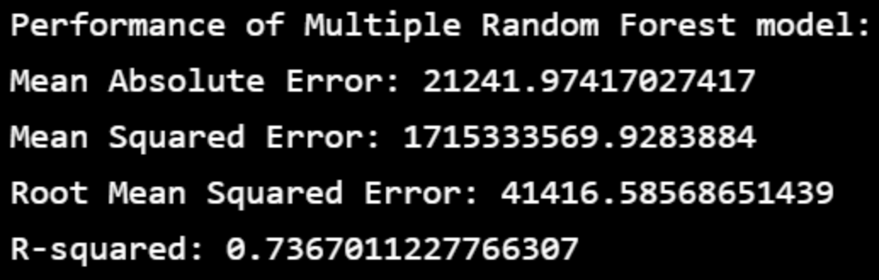
Analysis on the Machine Learning Model Model 1
Random Forest
n_estimators
The number of decision trees the model will be running.
random_state
Sets a seed to the random generator.
Outputs
MEA: 21,241.974
MSE (Mean Squared Error): 1,715,333,569.928
RMSE (Root Mean Squared Error): 41,416.586
R-Squared: 0.737

Slide 10
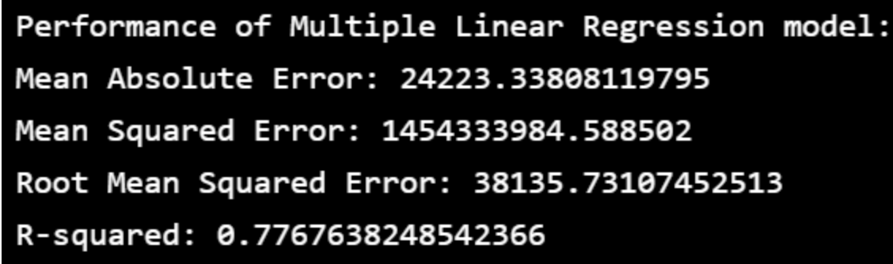
Analysis on the Machine Learning Model Model 2
Multiple Linear Regression(MLR)
It is used for determining the relationship between variables and forecasting.
Outputs
MEA: 24,223.338
MSE: 1,454,333,984.589
RMSE: 38,135.731
R-Squared: 0.777 The results from the Linear
Regression model are similar, but not the same, as the Random Forest model.

Slide 11
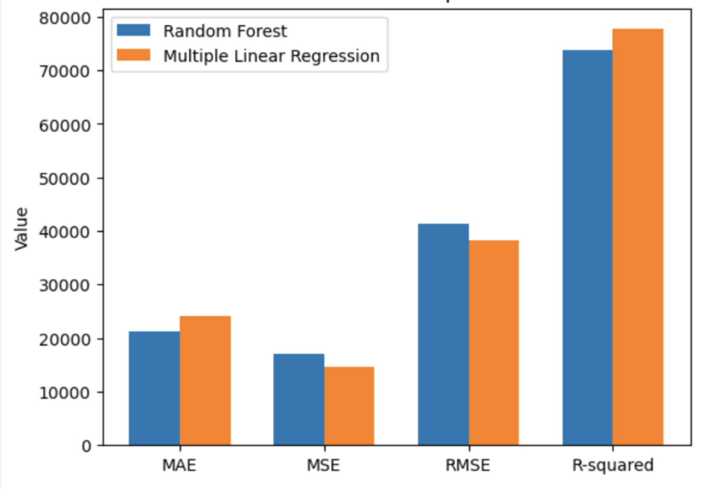
Performance Comparison

Slide 12
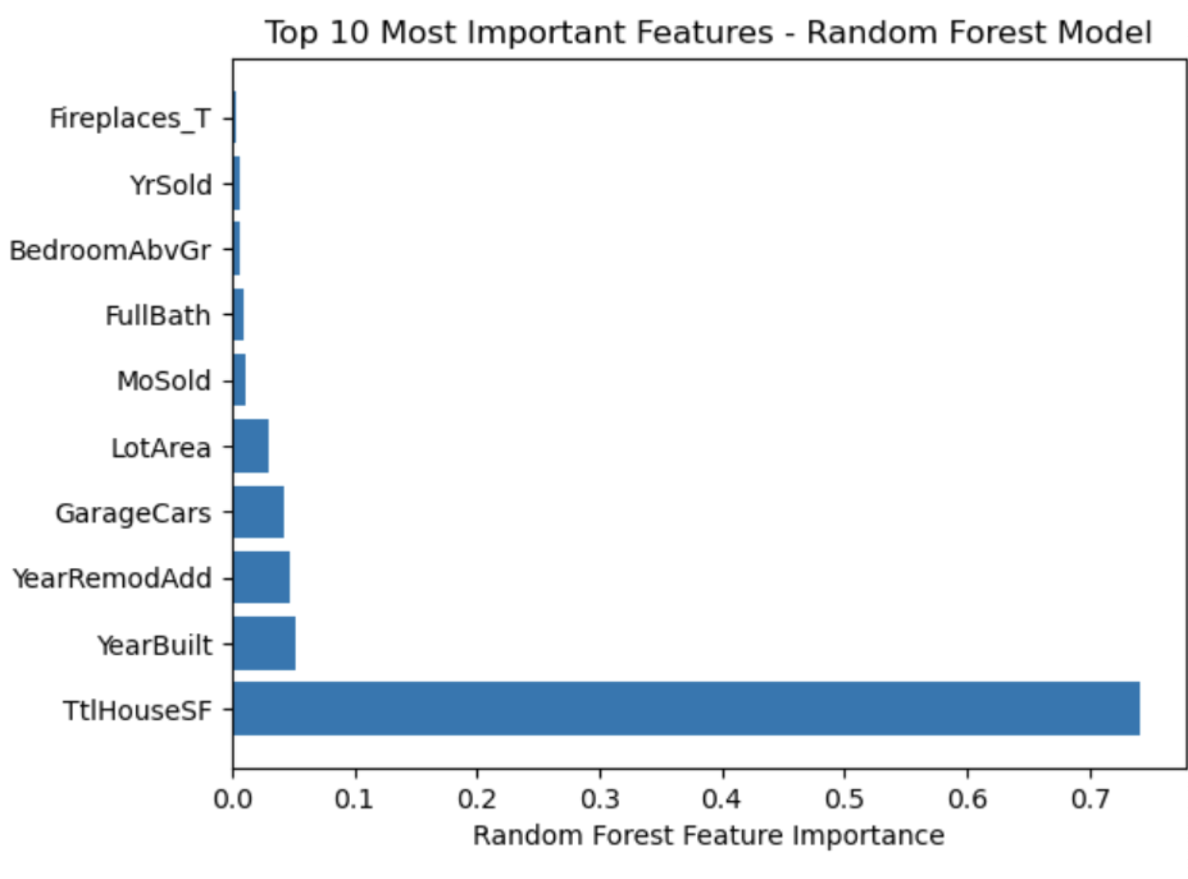
Top 10 Most Important Features

Slide 13
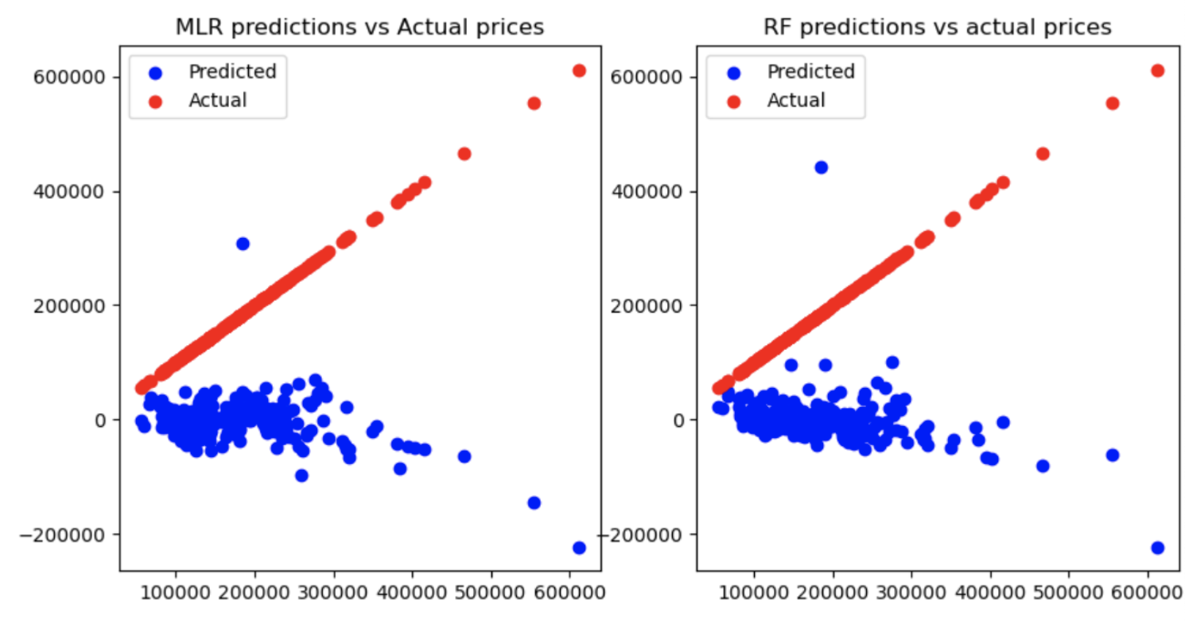
Visualization of Predicted Values Vs. Actual Values

Slide 14
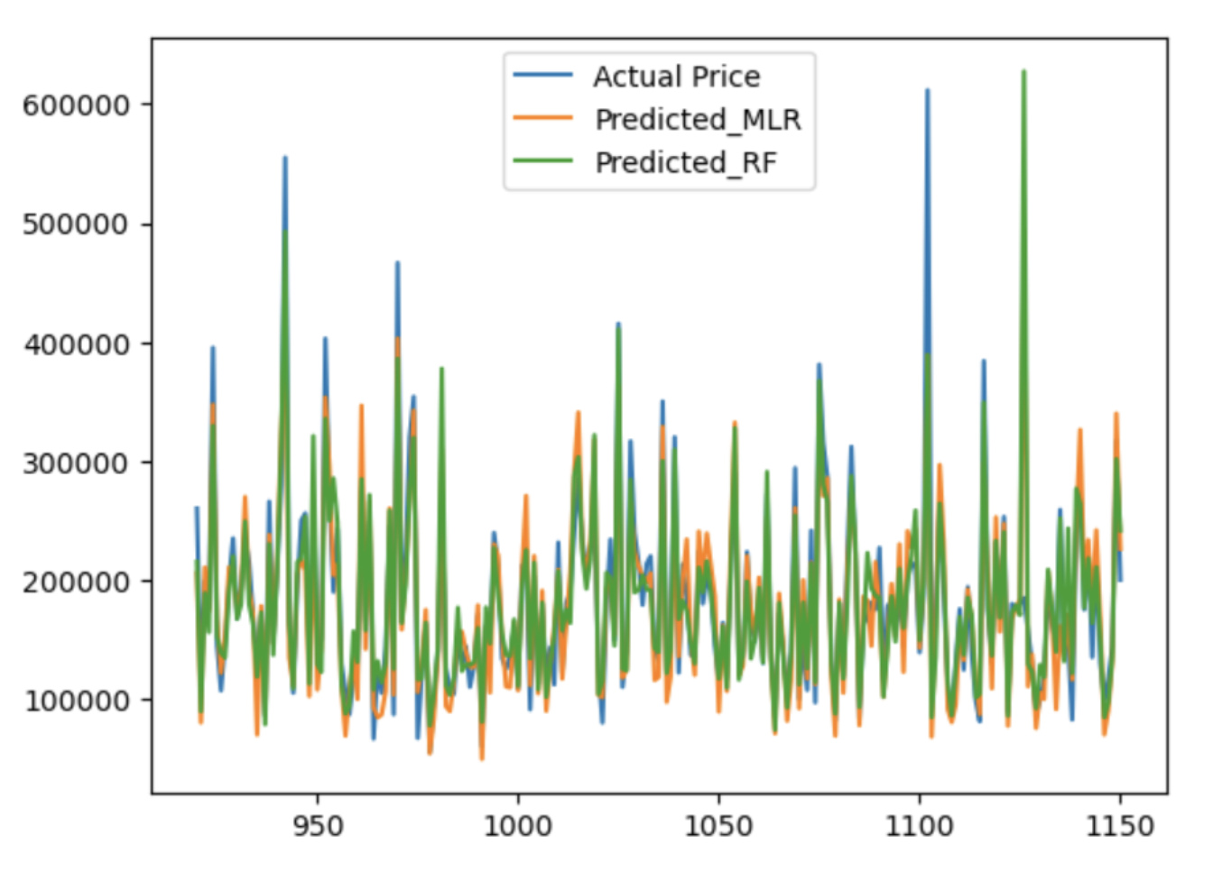
Visualization of Predicted Values Vs. Actual Values

Slide 15
Thank You!

